Slide 1

Global AQI Study: Traditional ML vs. Deep Learning Approaches
Data 495 Data Science Capstone
Heyda I. Alvarado Alvelo
Professor: Linesh Dave

Slide 2

Agenda:
Project Description
Background
Objectives
Dataset Description
The Data
Statistics
Visualizations
Histogram
Correlation Matrix
Models
Preprocessing Techniques
XGBoost
MLP
Findings
Confusion Matrix
Classification Report
Recommendations
References
Possible Issues
XGBoost Tree
Lessons Learned
ROC-AUC
LIME Explainer

Slide 3

Project Description: Background
The Clean Air Act
What are the main air pollutants?
Carbon Monoxide (CO)
Nitrogen Dioxide (NO2)
Ozone (O3)
Particulate Matter (PM 2.5)
Notes:
The Clean Air Act is recognized for its role in improving air quality, both in the United States and globally, by introducing a risk communication requirement. This mandate includes the consistent monitoring of air quality across the United States and the daily reporting of air quality through a uniform Air Quality Index (AQI) (Perlmutt & Cromar, 2019).
CO is a colorless, odorless gas that can be harmful when inhaled in large amounts. CO is released when something is burned. The greatest sources of CO to outdoor air are cars, trucks, and other vehicles or machinery that burn fossil fuels. A variety of items in your home such as unvented kerosene and gas space heaters, leaking chimneys and furnaces, and gas stoves also release CO and can affect air quality indoors (EPA, 2023).
Nitrogen Dioxide (NO₂) is one of a group of highly reactive gases known as oxides of nitrogen or nitrogen oxides (NO_{x}). NO₂ primarily gets in the air from the burning of fuel. NO₂ forms from emissions from cars, trucks and buses, power plants, and off-road equipment (EPA, 2023).
Ozone is a gas composed of three atoms of oxygen. Ozone occurs both in the Earth's upper atmosphere and at ground level. Ozone can be good or bad, depending on where it is found. Ozone at ground level is a harmful air pollutant, because of its effects on people and the environment, and it is the main ingredient in “smog“(EPA, 2023).
PM stands for particulate matter (also called particle pollution): the term for a mixture of solid particles and liquid droplets found in the air. Some particles, such as dust, dirt, soot, or smoke, are large or dark enough to be seen with the naked eye. Others are so small they can only be detected using an electron microscope. PM_{2.5} are fine inhalable particles, with diameters that are generally 2.5 micrometers and smaller (EPA, 2023).

Slide 4
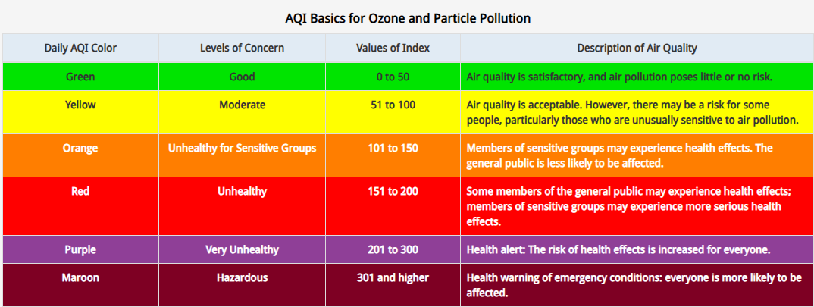
Project Description: Background (cont.)
Notes:
According to the Clean Air Act's guidelines, the AQI is determined based on the pollutant with the highest concentration relative to its regulatory standard for the day. This index ranges from 0 to 500, with 100 representing the national air quality concentration standard for a pollutant. The implementation of the Clean Air Act has significantly contributed to the understanding and management of air quality concerns, emphasizing the need for advanced data analytics techniques in the field (Perlmutt & Cromar, 2019).

Slide 5

Project Description: Objectives
Comprehend Air Pollution Dynamics
Create Robust Predictive Models
Compare Traditional ML vs Deep Learning Approaches
Enhance Transparency with Explainable AI
Notes:
The problem at hand involves the critical examination and comparison of traditional machine learning approaches with deep learning algorithms in the context of Air Pollution Categorization (Classification).
Traditional machine learning models offer a robust framework for understanding the intricate relationships between various atmospheric pollutants and their corresponding Air Quality Index (AQI) values. On the other hand, deep learning algorithms, with their capacity to process complex and unstructured data, provide a promising avenue for exploring more nuanced patterns and correlations within the air pollution dataset.
By conducting a comparative analysis of these methodologies, the study aims to shed light on the efficacy of different analytical techniques in predicting and categorizing air pollution, ultimately contributing to the development of more accurate and efficient predictive models for air quality management and environmental sustainability.
This project will leverage explainable AI techniques like SHAP (SHapley Additive exPlanations) and LIME (Local Interpretable Model-agnostic Explanations) to enhance the interpretability of the models and provide insights into the factors influencing the predictions.

Slide 6
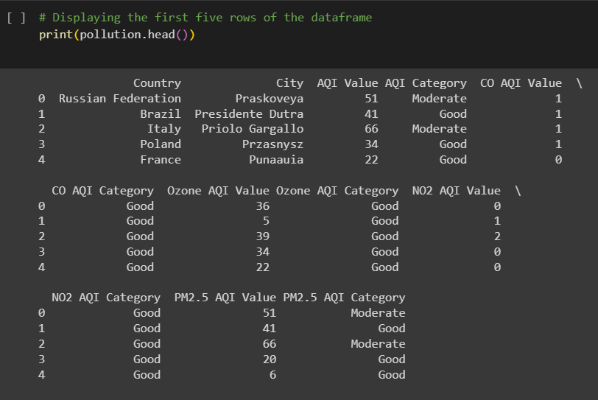
Data Set Description
Global Air Pollution Dataset
Data from 300 cities around the world
23,463 individual instances
Collected from eLichens Air Pollution Map
Notes:
The Global Air Pollution Dataset (Muzdadid, 2022) is a comprehensive compilation of atmospheric data, featuring 12 distinct columns (variables) and 23,463 individual instances. This extensive dataset offers a thorough exploration of air quality parameters across 300 cities worldwide.
The dataset was collected from eLichens (Global Air Quality Map), which is a platform that provides comprehensive environmental monitoring solutions. The platform's focus is on collecting data related to air quality and enabling businesses, cities, and individuals to make informed decisions about environmental issues. The original data was collected through various environmental monitoring devices and sensors deployed in different cities across the world. These devices measure the concentration levels of pollutants like NO2, O3, CO, and PM2.5 in the air.
The data collection process involves continuous monitoring over specific time intervals to capture the variations in air quality levels, allowing for the generation of the Air Quality Index (AQI) values for each pollutant (Global Air Quality Map.
The dataset-specific time range is unknown

Slide 7
Describe the Data:
Source: Kaggle
Instances (rows): 23,463
Variables (columns): 12
Blanks:
427 in ‘Country’ column
1 in ‘City’ column
Notes:
The Global Air Pollution Dataset (Muzdadid, 2022), downloaded from Kaggle, is a comprehensive compilation of atmospheric data with 12 distinct columns (variables) and 23,463 individual instances. In this dataset 427 instances contain blank entries for the 'Country' column, and 1 instance has a blank entry for the 'City' column.

Slide 8
Describe the Data (cont):
Numerical Variables
AQI Value: Overall AQI value of the city
CO AQI Value: AQI value of Carbon Monoxide of the city
Ozone AQI Value: AQI value of Ozone of the city
NO2 AQI Value: AQI value of Nitrogen Dioxide of the city
PM2.5 AQI Value: AQI value of Particulate Matter with a diameter of 2.5 micrometers or less of the city
Categorical Variables
Country: Name of the country
City: Name of the city
AQI Category: Overall AQI category of the city
CO AQI Category: AQI category of Carbon Monoxide of the city
Ozone AQI Category: AQI category of Ozone of the city
NO2 AQI Category: AQI category of Nitrogen Dioxide of the city
PM2.5 AQI Category: AQI category of Particulate Matter with a diameter of 2.5 micrometers or less of the city
Notes:
In this dataset, we encounter both numerical and categorical variables. Despite the presence of some blank columns, the 'City' and 'Country' columns will not be utilized in this project. Since the focus is on a classification task centered around the Air Quality Index (AQI), the geographical location represented by these columns is deemed irrelevant for the project's objectives.
Additionally, the variables in the dataset encompass both string and integer data types.
The Air Quality Index (AQI) values, both overall and for individual pollutants, may vary significantly depending on the specific pollutant being measured. While some numerical values might appear as outliers within the dataset, it is important to note that these values fall within the established AQI range for each pollutant. During the initial stages of this project, we are not identifying these values as outliers. They may indicate deviations from normal concentrations and will be further analyzed in subsequent phases of the project.
In the AQI categories for different pollutants, it is observed that not all categories are uniformly present. This variation in the distribution of categories across pollutants may potentially lead to class imbalance issues during model training.

Slide 9
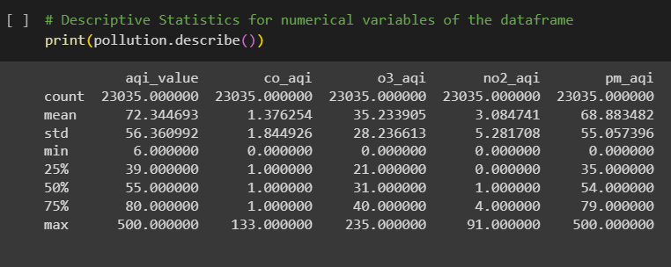
Describe the Data (cont): Descriptive Statistics
Notes:
The aqi_value (AQI Value) variable has a wide range with a considerable standard deviation (56.06), indicating variability in air quality measurements. The quartiles (25th, 50th, and 75th percentiles) of 39.00, 55.00, and 79.00, coupled with a mean of 72.01, indicate a moderately right-skewed distribution. This suggests that a significant proportion of air quality index values cluster around the lower to middle range, with a long tail towards higher values, exemplified by the maximum value of 500.
The co_aqi (CO AQI Value) variable appears to have low variability, as indicated by the small standard deviation (1.83) and consistent values across quantiles. Most values fall within the 25th to 75th percentiles. This indicates a limited variability in carbon monoxide air quality index readings, with most values falling within a narrow range, despite a maximum value of 133.
The o3_aqi (Ozone AQI Value) variable exhibits moderate variability, with a wider range and standard deviation (35.19) compared to co_aqi. With quartiles (25th, 50th, and 75th percentiles) of 21.00, 31.00, and 40.00, and a mean of 35.19, the distribution of ozone air quality index values appears moderately right skewed. While the majority of values cluster around the lower to middle range, the presence of higher values contributes to a gradual rightward spread, as reflected in the maximum value of 235.
The no2_aqi (NO2 AQI Value) variable shows variability, with a substantial proportion of values at or near zero. The standard deviation (5.25) indicates a spread of data. The quartiles (25th, 50th, and 75th percentiles) of 0.00, 1.00, and 4.00, along with a mean of 3.06, indicate a distribution skewed to the right for nitrogen dioxide air quality index values. Most readings are concentrated at or near zero, emphasizing instances of low pollution levels, while higher values contribute to the rightward skewness, as illustrated by the maximum value of 91.
The pm_aqi (PM2.5 AQI Value) variable has a distribution like aqi_value, with a wide range and notable standard deviation (68.52). The quantiles provide a detailed view of the distribution of particulate matter AQI values. The quartiles (25th, 50th, and 75th percentiles) of 35.00, 54.00, and 79.00, along with a mean of 68.52, suggest a distribution slightly skewed to the right. The presence of a sizable number of values towards the upper range, as evidenced by the maximum value of 500, highlights instances of elevated particulate matter air quality index readings.

Slide 10
Describe the Data (cont): Possible Issues
Overfitting
Class Imbalance
Notes:
The model might overfit to the anomalies, capturing the noise or specific patterns present in those instances but not relevant to the general distribution of the data. As a result, the model's performance on new, unseen data may be compromised.
Anomalies often represent a minority class in the dataset. Class imbalance can lead to skewed model performance metrics, as the algorithm may prioritize accuracy on the majority class while neglecting the minority class.

Slide 11
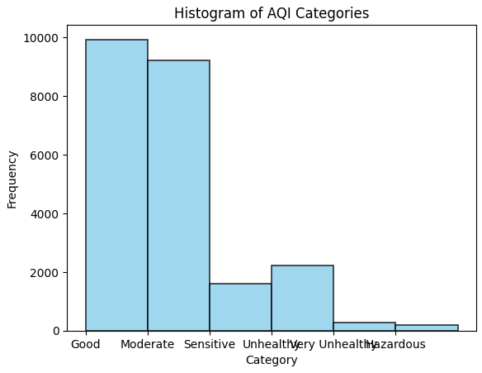
Visualizations: Histogram Target Variable
Notes:
Histogram Overview: The histogram visually captures the frequency distribution of air quality categories, presenting a comprehensive snapshot of the dataset. Each bar on the x-axis corresponds to specific AQI categories, and the y-axis measures occurrences on a scale from 0 to 10,000. Notably, the histogram exhibits a rightward skew, indicating variations in the frequency of different air quality categories.
Counterintuitive Relationship: Upon closer examination, the visualization challenges expectations by revealing an unexpected relationship between the 'Sensitive' and 'Unhealthy' categories. Contrary to the anticipated trend, the 'Sensitive' category does not surpass the 'Unhealthy' category in frequency. This counterintuitive discovery prompts a deeper exploration of the factors influencing these two categories, adding complexity and nuance to our understanding of air quality dynamics.

Slide 12
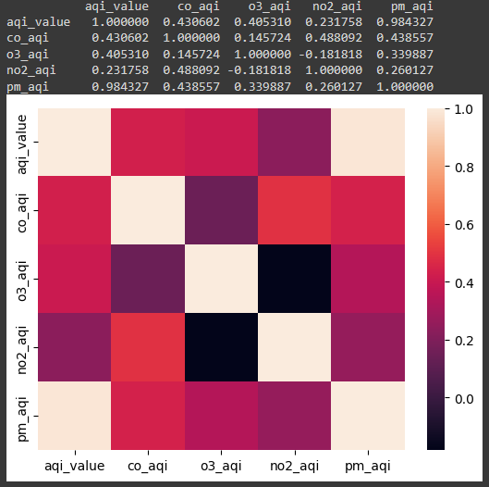
Visualizations: Correlation Matrix
Notes:
Dominant Positive Correlation: The correlation matrix reveals a robust positive correlation (0.984327) between 'AQI Value' and 'PM2.5 AQI,' emphasizing that as the overall air quality index increases, particulate matter AQI values tend to rise as well. The unique strength of this relationship is visually evident in the beige-colored squares in the matrix, suggesting practical implications for data column retention.
Nuanced Relationships and Negative Correlations: Dark purple shades in the matrix highlight a negative correlation (-0.181818) between 'O3 AQI' and 'NO2 AQI,' indicating an inverse relationship. Understanding this interplay introduces strategic considerations for column inclusion, suggesting that both ozone and nitrogen dioxide AQI values could offer a more comprehensive view of air quality dynamics. However, it prompts a nuanced evaluation of redundancy for refined and efficient analysis.

Slide 13
Models: Preprocessing
Column Renaming
Feature Selection
Standardized Naming Convention
Data Segmentation
Categorical Variable Encoding
Target Variable Encoding
Normalization (MLP Model)
Train-Test Data Split
Notes:
Data Preprocessing Steps:
Column Renaming: Enhanced readability by giving columns more descriptive names.
Feature Selection: Dropped the "City" column due to unique values for each instance, streamlining the dataset. Identified and dropped all rows containing nulls.
Standardized Naming Convention: Replaced blank spaces in the whole dataset with underscores, ensuring a consistent and standardized naming convention.
Data Segmentation: Divided the data into Dependent and Independent variables, establishing a clear distinction between target and predictor variables.
Categorical Variable Encoding: Utilized Pandas 'get_dummies' to encode categorical variables, transforming them into a numerical format suitable for modeling.
Target Variable Encoding: Employed Label Encoder to encode the target variable, preparing it for machine learning model training.
Normalization (MLP Model): Applied StandardScaler to normalize data, particularly beneficial for the Multilayer Perceptron (MLP) model, ensuring consistent scales
Train-Test Data Split: Segregated the dataset into Train and Test sets, enabling the model to learn from one portion and validate its performance on another.

Slide 14
Models: XGBoost for AQI Prediction
Exceptional Performance Metrics
Handling Imbalanced Datasets
Proven Success in Literature
Real-time Dataset Advantage
Health Implications and Environmental Impact
Notes:
XGBoost, or Extreme Gradient Boosting, stands out as a formidable model for predicting Air Quality Index (AQI) due to its robust capabilities within the Gradient Boosting framework. Here's why XGBoost is a compelling choice and its benefits for AQI prediction:
1. Exceptional Performance Metrics: XGBoost exhibits remarkable accuracy, as reflected in key performance metrics such as Mean Absolute Error (MAE), Root Mean Squared Error (RMSE), and R-squared (R2). These metrics highlight the model's ability to predict AQI values with high precision.
2. Handling Imbalanced Datasets: One of XGBoost's notable strengths is its effectiveness in handling imbalanced datasets, a common characteristic in air quality data. This capability ensures reliable predictions even when faced with unevenly distributed instances of different AQI categories.
3. Proven Success in Literature: Studies, including the work by Van et al. (2022, as cited in Sarkar et al., 2022) and Nigam et al. (2015, as cited in Sarkar et al., 2022), emphasize XGBoost's consistent success in AQI prediction. This recognition is vital for establishing the model's credibility and suitability for environmental applications.
4. Real-time Dataset Advantage: XGBoost's accuracy is further enhanced when applied to real-time datasets, as highlighted by research. This feature positions the model as a valuable tool for dynamic and responsive air quality management, crucial for addressing environmental challenges promptly.
5. Health Implications and Environmental Impact: Recognizing the severe health implications of air pollution, XGBoost's precision in predicting AQI emerges as a critical asset for proactive air quality management. By providing timely and accurate predictions, the model contributes to public health interventions and supports the overarching goal of mitigating the adverse effects of pollution on human health and the environment.
In summary, XGBoost's combination of exceptional accuracy, adaptability to imbalanced datasets, proven success in literature, real-time applicability, and its potential to positively impact public health makes it a powerful and suitable model for AQI prediction. Its contributions extend beyond predictive analytics, offering valuable insights for informed decision-making in environmental management.

Slide 15
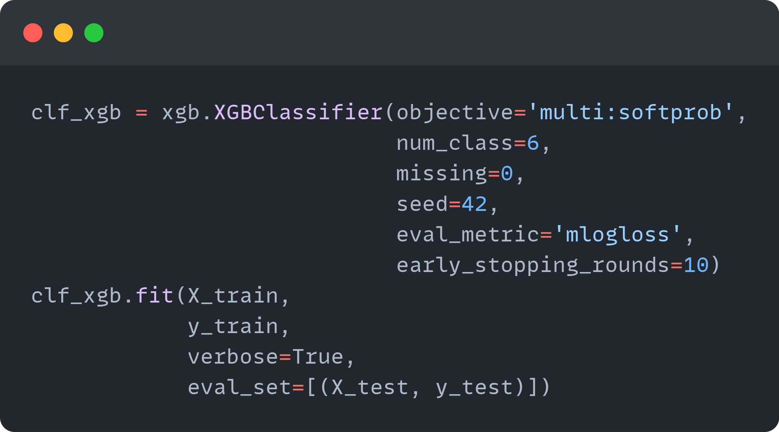
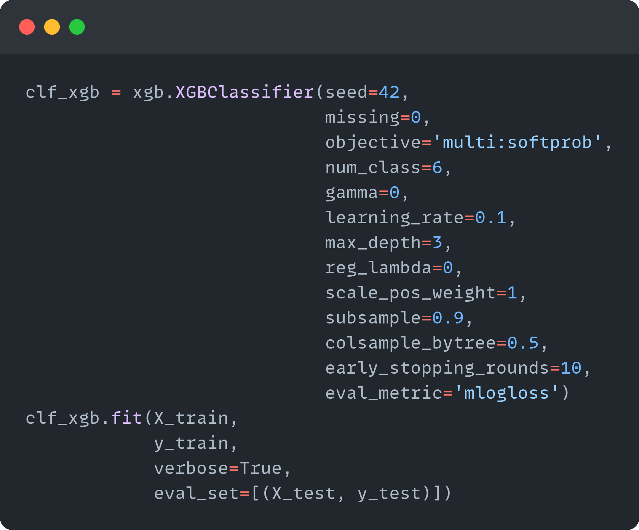
Models: XGBoost Preliminary Model vs Optimized Model
Preliminary
Optimized
Notes:
Algorithm: XGBoost
Hyperparameter Strategy:
Tuning: Used GridSearchCV for fine-tuning.
XGBoost Configuration:
Parameters: Tuned 'gamma,' 'learning_rate,' 'max_depth,' 'subsample.'
Evaluation Metric:
Chose 'mlogloss' for multi-class classification.
Measures accuracy of predicted probabilities, penalizing lack of confidence.
Calibration Focus:
Objective: Well-calibrated probability estimates for each AQI category.
Ensures nuanced evaluation considering uncertainties.
Overall Approach:
Strengths: Robust XGBoost for complex relationships.
Metric Choice: 'mlogloss' for accurate probability predictions.
Calibration: Emphasis on calibrated probabilities for nuanced performance.

Slide 16
Models: MLP for AQI Prediction
Versatility and adaptability
Prominence in deep learning literature
Applicability to multi-class aqi prediction
Integration of innovative techniques
Demonstrated improvement in accuracy
Notable Applications in Different Regions
Notes:
In the realm of air quality prediction, Multi-Layer Perceptrons (MLPs) have emerged as a versatile and adaptable solution, evidenced by their prominence in predicting various pollutants across regions, their ability to handle multi-class AQI scenarios, and the incorporation of innovative techniques, such as Kalman filters and modified architectures, leading to improved accuracy in forecasting.
Versatility and Adaptability:
MLP models are versatile and adaptable, making them suitable for a wide range of applications, including air pollution prediction.
The adaptability is highlighted by the variations and improvements explored by researchers, such as incorporating Kalman filters and introducing modified architectures with rolling mechanisms and accumulated generating operations.
Prominence in Deep Learning Literature:
MLPs have gained prominence in the deep learning literature focused on air pollution prediction. This indicates their effectiveness and wide acceptance within the research community.
Applicability to Multi-Class AQI Prediction:
MLPs are capable of handling multi-class problems, making them suitable for predicting various air pollutants simultaneously, as indicated by their applications in predicting O3 levels and PM2.5 concentrations.
Notable Applications in Different Regions:
The mentioned applications of MLPs in predicting O3 levels in Corsica and PM2.5 concentrations in Northern China demonstrate their effectiveness across different geographical locations, indicating their generalizability.
Integration of Innovative Techniques:
Researchers have explored innovative techniques to enhance MLP models, such as incorporating Kalman filters and introducing rolling mechanisms and accumulated generating operations. These adaptations showcase the model's ability to integrate novel methods for improved accuracy.
Demonstrated Improvement in Accuracy:
The cited works by Hoi et al. (2013) and Fu et al. (2015) demonstrate that modifications to traditional MLP structures can lead to improved accuracy in predicting specific air pollutants like PM10 and PM2.5, respectively.
In summary, MLPs exhibit versatility, adaptability, and effectiveness in predicting air pollution levels, and their application in diverse regions and adaptation to specific needs highlight their strengths in the context of AQI prediction.

Slide 17
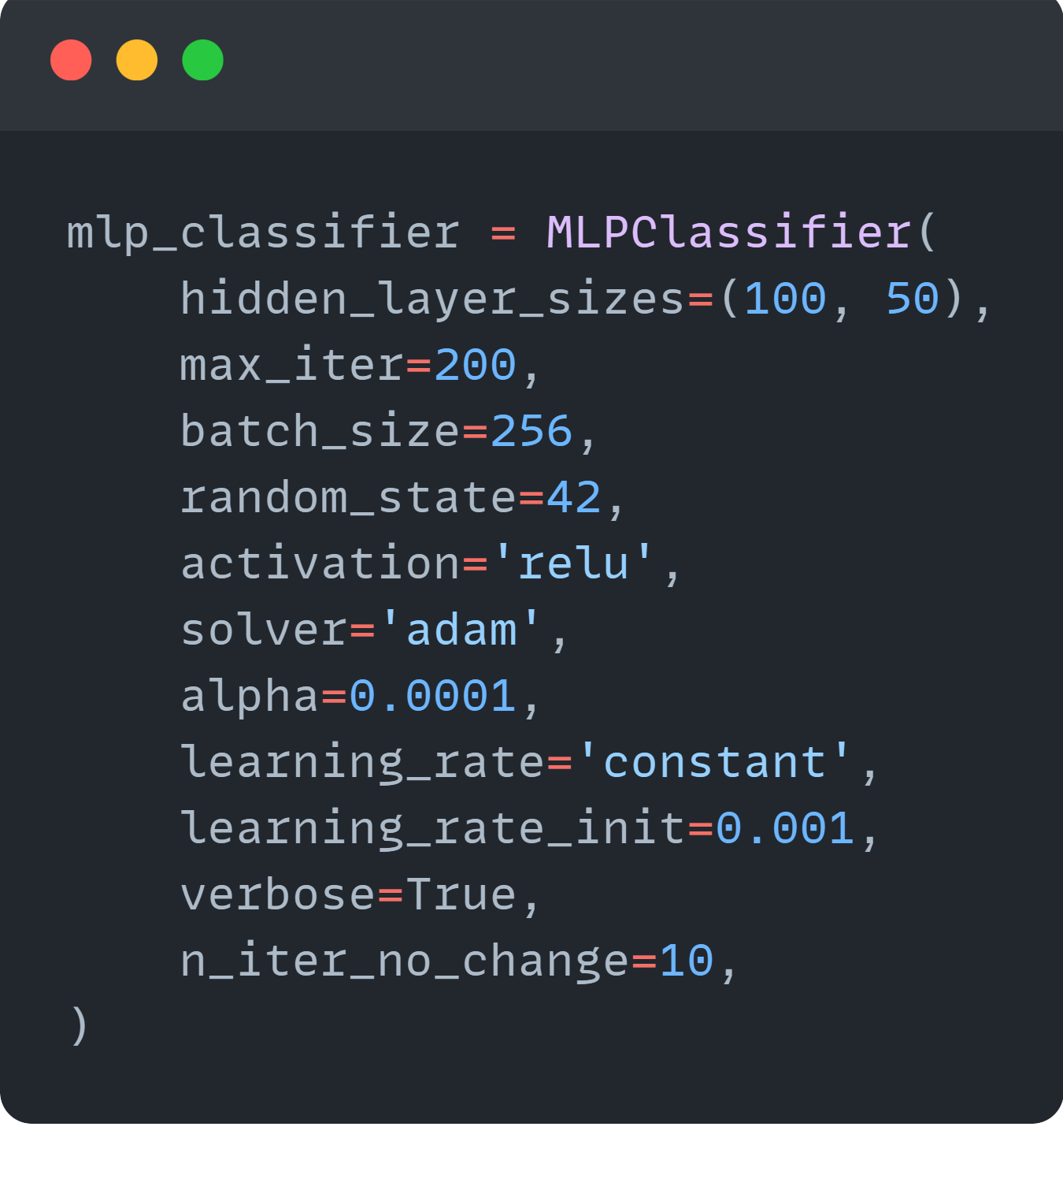
Models: MLP Model
Notes:
Algorithm: MLP Classifier
Hyperparameter Strategy:
Simplicity: Used default settings due to remarkable performance.
MLP Configuration:
Architecture: Two hidden layers (100 and 50 neurons) with ReLU activation.
Solver: 'adam' for efficient large dataset handling.
Training: 200 iterations, learning rate 0.001, batch size 256.
Regularization:
L2 penalty (alpha=0.0001).
Early stopping after 10 iterations without improvement.
Evaluation:
Results: Impressive precision, recall, and F1-scores (>90% for all AQI categories).
Default Settings Impact:
Robustness: Demonstrated robustness and effectiveness.
Baseline Strength: Impressive performance without hyperparameter fine-tuning.
Overall Approach:
Emphasis: Simplicity, efficiency, and robustness for strong baseline AQI prediction.

Slide 18
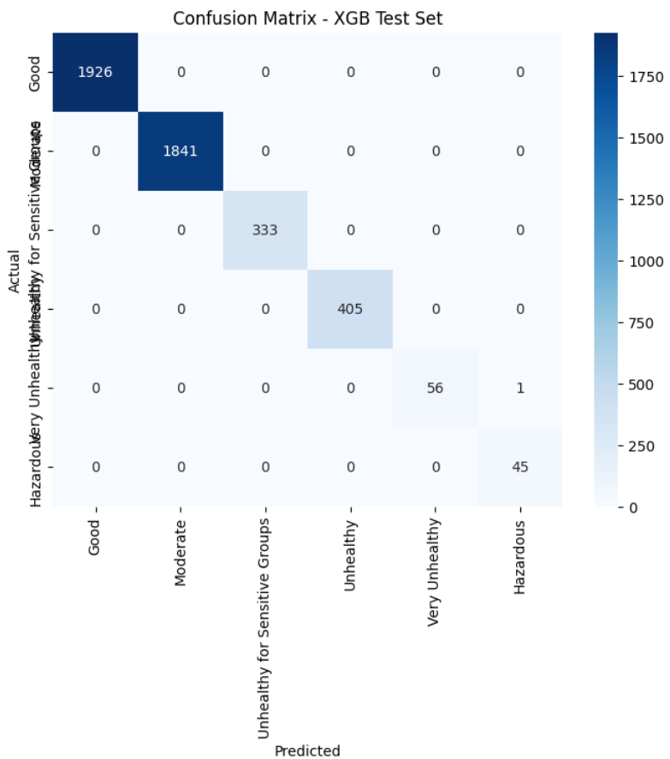
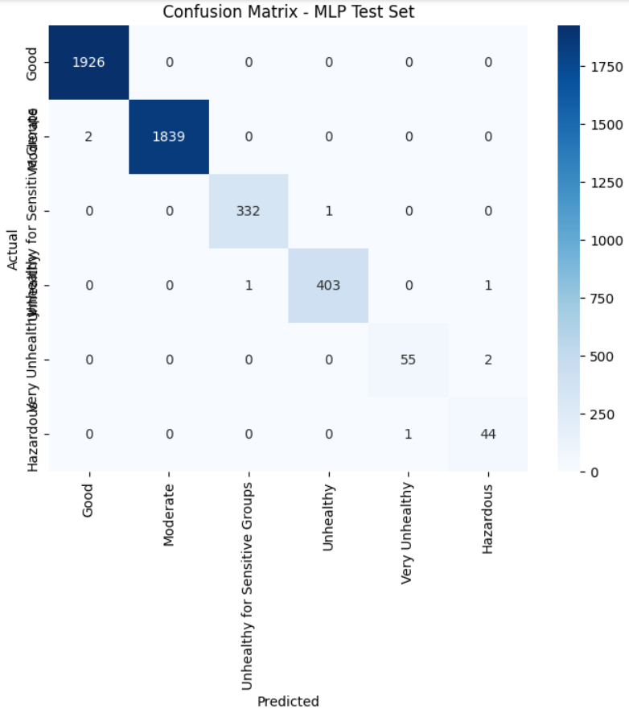
Findings: Confusion Matrix
Notes:
In analyzing the confusion matrices for the testing data of both the XGBoost and MLP models, it is evident that both models demonstrated exceptional performance in predicting the Air Quality Index (AQI) category. The accuracy scores for XGBoost and MLP were .999 and .998, respectively.
In terms of overall performance, both models achieved perfect accuracy on the training data. However, on the testing set, XGBoost outperformed MLP by misclassifying only one instance, whereas the MLP model misclassified 8 instances. Despite the presence of an unbalanced dataset, both models surpassed expectations in their predictive capabilities.
Therefore, based on the results, the Champion Model for AQI Classification is XGBoost, although it is noteworthy that MLP's performance was nearly on par with XGBoost.

Slide 19
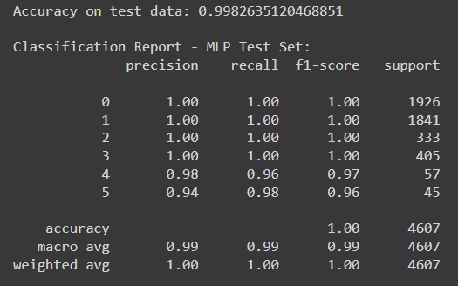
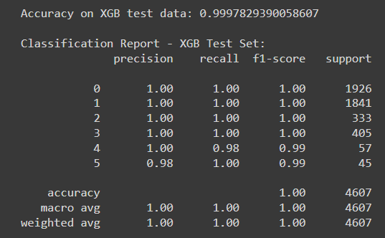
Findings: Classification Report
Notes:
Both models demonstrate outstanding accuracy.
Class-wise metrics reveal high precision, recall, and F1-scores, indicating robust performance across all classes.
Some minor variations in performance in classes 4 and 5, most likely due to fewer instances of those classes (Unbalanced data), but overall, the models are highly reliable for the given classification task.
The XGBoost model has a slightly higher accuracy, suggesting it performs marginally better on the test data compared to the MLP model was nearly on par with XGBoost.

Slide 20
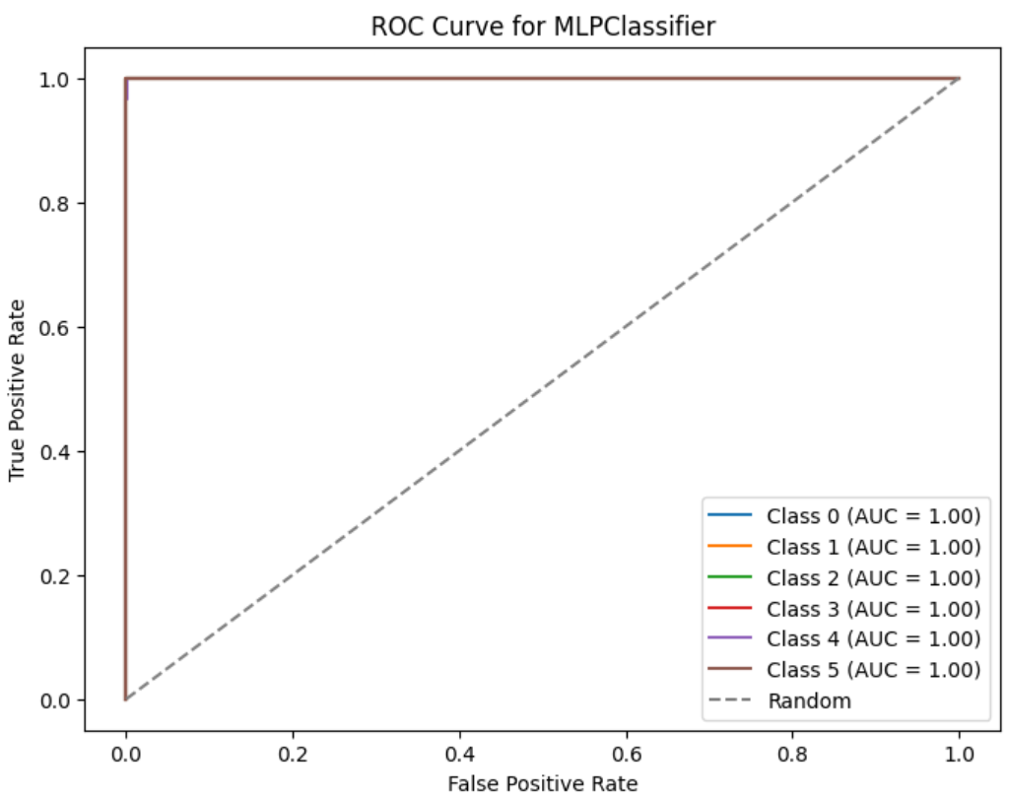
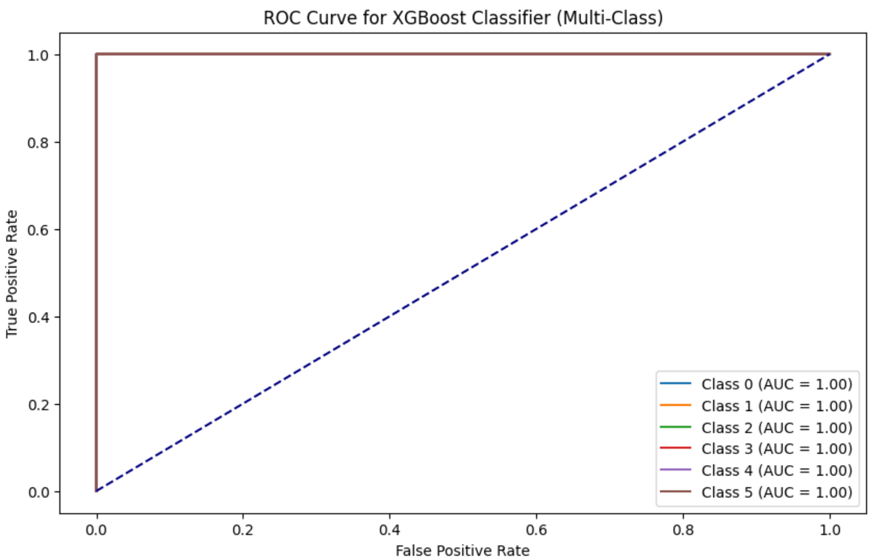
Findings: ROC-AUC
Notes:
The XGBoost and MLP classifiers excel with a perfect ROC AUC score of 1 across all six classes, showcasing exceptional balance between sensitivity and specificity. Their accuracy in discriminating between positive and negative instances, coupled with consistently high performance across all classes, reflects robust learning and rare reliability. The models exhibit proficiency in delivering precise predictions, highlighting their ability to handle diverse patterns and maintain accuracy across the spectrum of classes.

Slide 21
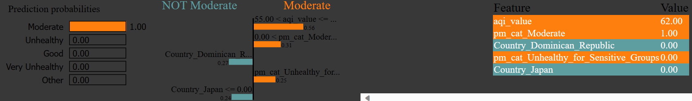
Findings: XGBoost LIME Explainer
Notes:
The XGBoost model confidently predicts the "Moderate" class for the 10th instance with a robust confidence level of 1.00, as indicated by the LIME explainer. Specific feature thresholds play a pivotal role, particularly when the country is neither the Dominican Republic (0.27) nor Japan (0.24). The absence of the "Particulate Matter 2.5 Unhealthy for Sensitive Groups" category (pm_cat_Unhealthy_for_Sensitive_Groups: 0) is a notable contributing factor. LIME provides valuable insights into how distinct features, including the overall AQI Value (0.56), a Moderate Particulate Matter 2.5 Category (0.31), and specific country thresholds, collectively support the model's confident forecast. This concise analysis offers a clear understanding of the decision-making process for the 10th instance, emphasizing the importance of specific features in shaping the model's predictions.

Slide 22
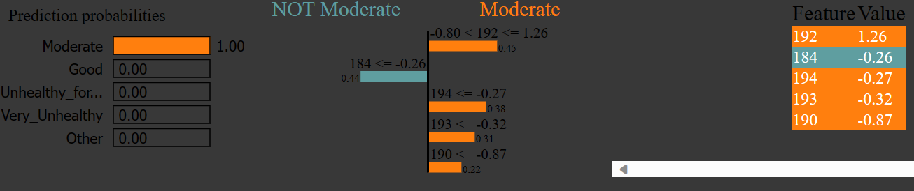
Findings: MLP LIME Explainer
Notes:
The MLP model predicts the "Moderate" class with high confidence (1.00) for the 10th instance. Notable features influencing this prediction include o3_cat_Moderate (feature 184, weight: 0.44), pm_cat_Moderate (feature 192, weight: 0.45), pm_cat_Unhealthy_for_Sensitive_Groups (feature 194, weight: 0.38), pm_cat_Unhealthy (feature 193, weight: 0.31), and pm_cat_Good (feature 190, weight: 0.22). Distinct from other models, the MLP operates as an unsupervised learning algorithm, emphasizing its unique predictive nature. This concise analysis highlights key features driving the MLP model's confident prediction for the 10th instance, underlining its distinctiveness as an unsupervised learning approach.

Slide 23
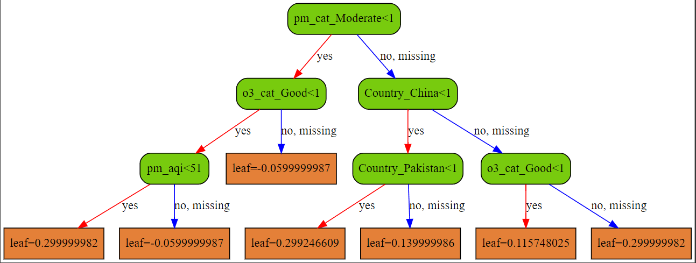
Findings: XGBoost Tree
Notes:
The structure of the first tree indicates a strong reliance on features related to air quality indices, Country, and specific pollution categories.
Features like 'pm_aqi' and 'o3_aqi' play a crucial role in determining the model's decisions.

Slide 24

Recommendations:
Ensemble Models
Feature Engineering
Temporal Analysis
Advanced Parameter Tuning
Spatial Considerations
Notes:
Ensemble Models: Use models like Random Forest or Gradient Boosting for enhanced accuracy in capturing complex air quality relationships.
Feature Engineering: Improve predictions by experimenting with new features, such as lag features based on historical concentrations or meteorological data.
Temporal Analysis: Enhance accuracy through in-depth temporal analysis, considering patterns like seasons, weekdays, and holidays, along with external factors like weather conditions.
Advanced Hyperparameter Tuning: Optimize model performance with advanced techniques like Bayesian optimization or genetic algorithms, especially effective for complex models.
Spatial Considerations: Analyze spatial features and geographical context for insights into air quality dynamics. Incorporate GIS data or satellite imagery for enhanced spatial understanding.

Slide 25
Lessons Learned
Follow
Follow the project order deliberately.
Emphasize
Emphasize the importance of time management.
Leverage
Leverage existing resources effectively.
Unlock
Unlock the potential of a seemingly simple dataset.
Notes:
Follow the project order deliberately: Prioritize the established project sequence to maintain a structured and efficient workflow.
Emphasize the importance of time management: Recognize the critical role of effective time management to ensure timely progress and successful completion of tasks.
Leverage existing resources effectively: Optimize the utilization of available resources for enhanced productivity and project efficiency.
Unlock the potential of a seemingly simple dataset: Acknowledge the versatility of a straightforward dataset, exploring its full potential for meaningful insights and impactful results.

Slide 26

References
Air Now. (n.d.). AQI & Health. AQI & Health | AirNow.gov. https://www.airnow.gov/aqi-and-health/
Dutta, D., & Pal, S. K. (2022). Z-number-based AQI in rough set theoretic framework for interpretation of air quality for different thresholds of PM2.5 and PM10. Environmental Monitoring and Assessment, 194(9). https://doi.org/10.1007/s10661-022-10325-z
eLichens. (n.d.). Global Air Quality Map. eLichens. https://www.elichens.com/global-air-quality-map
EPA. (2018, September). Technical assistance document for the reporting of Daily Air Quality . Technical Assistance Document for the Reporting of Daily Air Quality – the Air Quality Index (AQI). https://www.airnow.gov/sites/default/files/2020-05/aqi-technical-assistance-document-sept2018.pdf
EPA. (2023, August 3). Air topics | US EPA - U.S. Environmental Protection Agency. Environmental Topics | Air Topics. https://www.epa.gov/environmental-topics/air-topics
Muzdadid, H. A. (2022, November 8). Global Air Pollution Dataset. Kaggle. https://www.kaggle.com/datasets/hasibalmuzdadid/global-air-pollution-dataset
Perlmutt, L. D., & Cromar, K. R. (2019). Comparing associations of respiratory risk for the EPA Air Quality Index and health-based air quality indices. Atmospheric Environment, 202, 1–7. https://doi.org/10.1016/j.atmosenv.2019.01.011
Sarkar, N., Gupta, R., Keserwani, P. K., & Govil, M. C. (2022). Air Quality index prediction using an effective hybrid deep learning model. Environmental Pollution, 315, 120404. https://doi.org/10.1016/j.envpol.2022.120404

